Slide 1

LOAN DEFAULT PREDICTION SYSTEM
By
116A3044 Anushka Patil
116A3050 Sara Nayak
Under Guidance of Prof. Seema Redekar

Slide 2
Index
1. Introduction
2. Proposed System
3. Algorithm
4. Code
5. Output And Analysis
6. Conclusion

Slide 3
Introduction
Distribution of loans is the core business part of almost every bank.
The prime objective in the banking environment is to invest their assets in safe hands.
Today many banks/financial companies approve loans after a regressive process of verification and validation but still there is no guarantee whether the chosen applicant is the deserving right applicant out of all the applicants.
Through this system we can predict whether that particular applicant is safe or not and the whole process of validation of features is automated by machine learning technique.

Slide 4
Proposed System
The dataset used here is Bank Loan Status Dataset from Kaggle.
The dataset contains 100514 entries with 19 columns.
The system is based on supervised learning.
We have used Decision Tree tool for classification and prediction.
The system will predict whether a loan should be sanctioned to a customer based on the customer’s previous loan payment history.

Slide 5
Algorithm
Step 1: Read the dataset.
Step 2: Clean Dataset (Replacing missing values).
Step 3:Splitting the Dataset into training and testing dataset.
Step 4: Train the model.
Step 5: Validate the model.

Slide 6
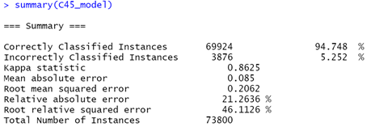

Output

Slide 7
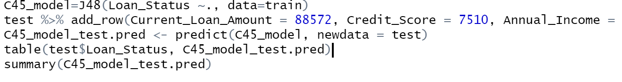
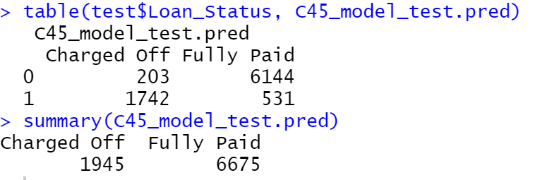
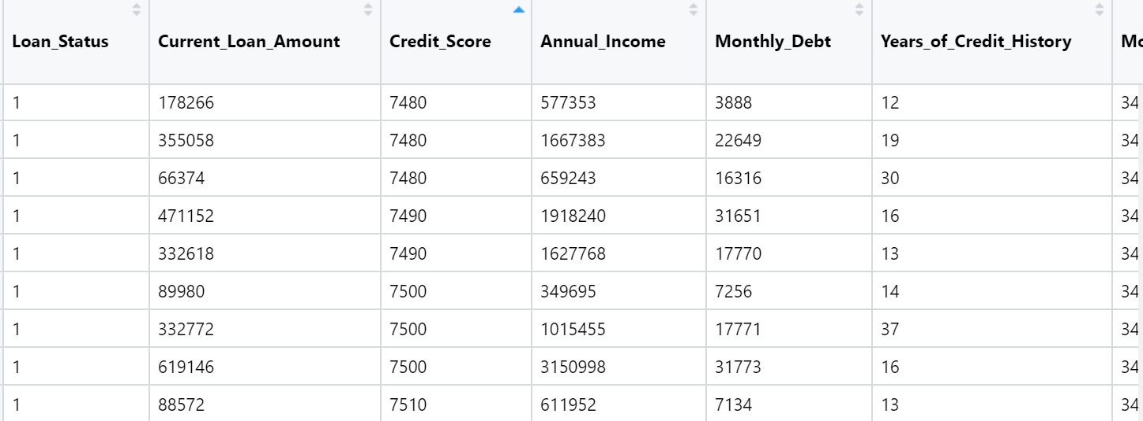
Output
Prediction -

Slide 8
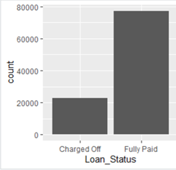
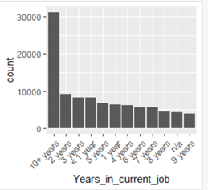
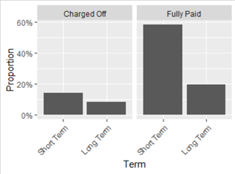
Output

Slide 9
Conclusion
We can conclude that the number of customers having Annual Income more than Rs.308587 (mean) and paying off the loan constitutes to more than 99% of the customers who paid off the loan. Thus, the bank can provide loans to customers having Annual Income of more than Rs308587 (mean).
The analysis shows that the probability of short term loans being fully paid is almost double the probability of long term loans being fully paid.
It can also be observed that Debt Consolidation is the most popular reason behind taking a loan. Almost 79% of the loans taken for Debt Consolidation are paid off. Debt consolidation is a form of debt refinancing that entails taking out one loan to pay off many others.
We also analysed the relationship between Monthly Debt and Loan Status. More than 41% of the customers who had Monthly Debt of more than Rs. 18472.41 could not pay the loan and were charged off by the bank.
We can also conclude that on the basis of feature selection and importance, the most important features for bank loan default prediction are - Credit Score, Current Loan Amount, Monthly Debt and Years of Credit History. Hence, the above inferences were drawn by the analysis of the bank loan dataset.

Slide 10
THANK YOU

